Slide 1


Randall Hidalgo Sánchez
2025-07-14
https://github.com/randall-hidalgosanchez/IBM-Capstone

Slide 2

Outline
Executive Summary
Introduction
Methodology
Results
Conclusion
Appendix

Slide 3
Executive Summary
Data was obtained through SPACEX API and complemented with information scrapped from Wikipedia’s article on Falcon9 launches. Data was cleaned and standardized as preparation for each of the following steps. Different visualizations were plotted and models tested.
The model that better fitted the data was a Decision Tree, however, that was a model with the best parameters as other models behaved better when using basic arguments.

Slide 4
Introduction
SpaceX advertises Falcon 9 rocket launches on its website, with a cost of 62 million dollars; other providers cost upward of 165 million dollars each, much of the savings is because SpaceX can reuse the first stage. Therefore, if we can determine if the first stage will land, we can determine the cost of a launch. This information can be used if an alternate company wants to bid against SpaceX for a rocket launch.
We will predict if the Falcon 9 first stage will land successfully.

Slide 5

Section 1

Slide 6
Methodology
Executive Summary
Data collection methodology:
Data was obtained from SpaceX API and complemented with Falcon9 launches information scrapped from Wikipedia
Perform data wrangling
Data was processed to obtain a variable “Outcome” with 1 meaning landing was successful and 0 meaning landing was not successful.
Perform exploratory data analysis (EDA) using visualization and SQL
Perform interactive visual analytics using Folium and Plotly Dash
Perform predictive analysis using classification models
Four models were tested: Logistic regression, SVM, Decision Trees and KNN.
Cross-validations was implemented to obtain the best parameters

Slide 7
Data Collection – SpaceX API
Retrieve the latest SpaceX launch data
Data was collected through SpaceX API
https://github.com/randall-hidalgosanchez/IBM-Capstone/blob/main/Scripts/01.%20jupyter-labs-spacex-data-collection-api.ipynb
Extract booster_name from rocket data
Extract launch_site info from launchpad data
Extract payload and orbit from payload data
Extract the outcome of the landing from cores data
Filter to use only Falcon9 data
Notes:
Extract rocket_id and launchpad_id from response

Slide 8
Data Collection - Scraping
Get Falcon9 launch records from a HTML table in Wikipedia
https://github.com/randall-hidalgosanchez/IBM-Capstone/blob/main/Scripts/02.%20jupyter-labs-webscraping.ipynb
Wikipedia Falcon9 launch records
Extract info from HTML table
Create a dataframe with the table info

Slide 9
Data Wrangling
Data was first checked for null values
Then, variables were checked to be the required type (numeric, categorical)
Number of launches on each site were calculated
Then, the number and occurrence of each orbit were also obtained
Lastly, a new variable was created with the landing outcome labeled
https://github.com/randall-hidalgosanchez/IBM-Capstone/blob/main/Scripts/03.%20labs-jupyter-spacex-Data%20wrangling.ipynb

Slide 10
EDA with Data Visualization
The relation between flight number and payload mass was plotted using a scatterplot and colored with the outcome. This helps to see if the payload has any effect on the outcome.
Then, flight numbers was plotted against launch site, again colored with launching outcome. This will help know if the site has any effect on the success of the landing.
Launch site was plotted against payload mass. This helps to know if the mass in conjunction with site affects the outcome.
Success rate was plotted for each orbit. This allows us to know if it is easier to land on certain orbits.
Success rate was plotted through time to know how the success has changed along time.
https://github.com/randall-hidalgosanchez/IBM-Capstone/blob/main/Scripts/05.%20pandas-matplotlib-edadataviz.ipynb

Slide 11
EDA with SQL
A table was first created containing SPACEX info
A query to obtain the name of each site was included
Then, a snippet of the data was shown
Total payload mass carried by boosters launched by NASA was calculated
Also, average payload mass carried by booster version F9 v1.1
Date of first successful landing was obtained
Finally, the count of landing outcomes were listed and ranked
https://github.com/randall-hidalgosanchez/IBM-Capstone/blob/main/Scripts/04.%20jupyter-labs-eda-sql-coursera_sqllite.ipynb

Slide 12
Build an Interactive Map with Folium
A map of the NASA Johnson Space Center at Houston, Texas was plotted to give context on the location.
Another map of the launching sites was added. This map also contains the outcome of each launch.
The distance from those launching sites to certain sites of interest were calculated.
https://github.com/randall-hidalgosanchez/IBM-Capstone/blob/main/Scripts/06.%20lab_jupyter_launch_site_location_interactive.ipynb

Slide 13
Build a Dashboard with Plotly Dash
A dropdown menu for each site
A pie chart showing the success rate
A slider for the payload range
A scatterplot showing the correlation between payload and launch success
https://github.com/randall-hidalgosanchez/IBM-Capstone/blob/main/Scripts/07.%20spacex-dash-app.py

Slide 14
Predictive Analysis (Classification)
Different models were tested to find which one fits better the data. Those models aim to predict successful launche.
Those models are: logistic regression, support vector machine, decisión tree, and K nearest neighbors
A confusión matrix of the results was plotted for each model
All models were compared utilizing their accuracy
https://github.com/randall-hidalgosanchez/IBM-Capstone/blob/main/Scripts/08.%20SpaceX_Machine%20Learning%20Prediction_Part_5.ipynb

Slide 15
Results
Exploratory data analysis results
Interactive analytics demo in screenshots
Predictive analysis results

Slide 16

Section 2

Slide 17
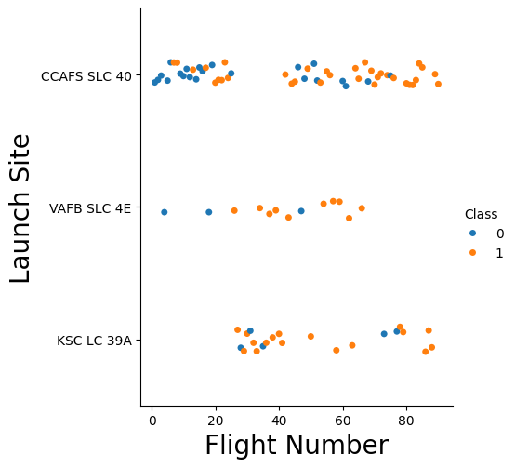
Flight Number vs. Launch Site
Show a scatter plot of Flight Number vs. Launch Site
Show the screenshot of the scatter plot with explanations

Slide 18
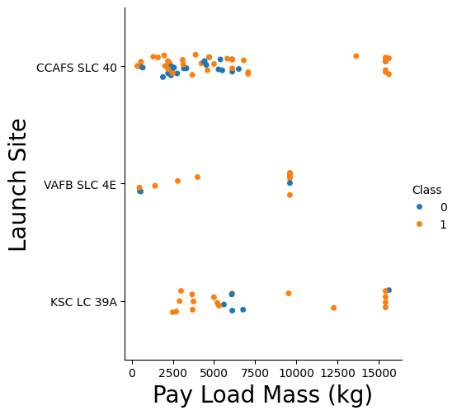
Payload vs. Launch Site
Show a scatter plot of Payload vs. Launch Site
Show the screenshot of the scatter plot with explanations

Slide 19
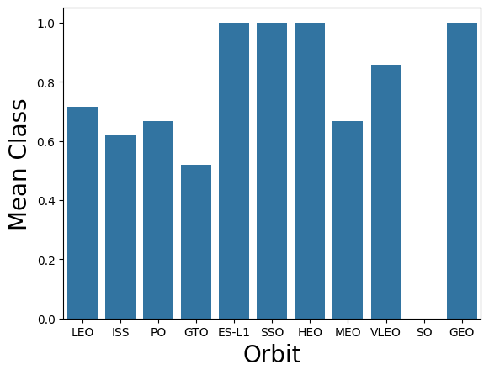
Success Rate vs. Orbit Type
Show a bar chart for the success rate of each orbit type
Show the screenshot of the scatter plot with explanations

Slide 20
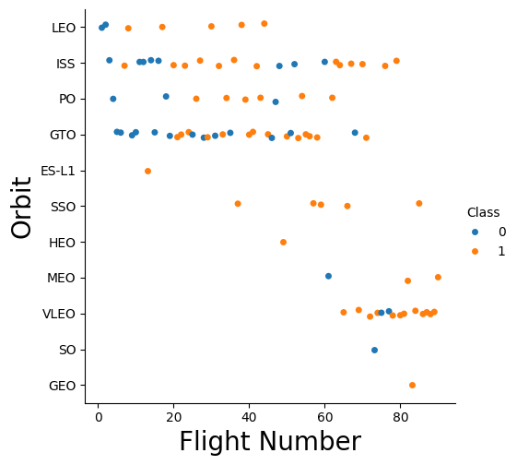
Flight Number vs. Orbit Type
Show a scatter point of Flight number vs. Orbit type
Show the screenshot of the scatter plot with explanations

Slide 21
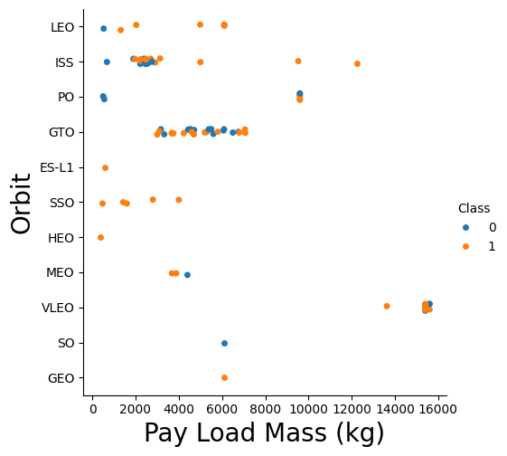
Payload vs. Orbit Type
Show a scatter point of payload vs. orbit type
Show the screenshot of the scatter plot with explanations

Slide 22
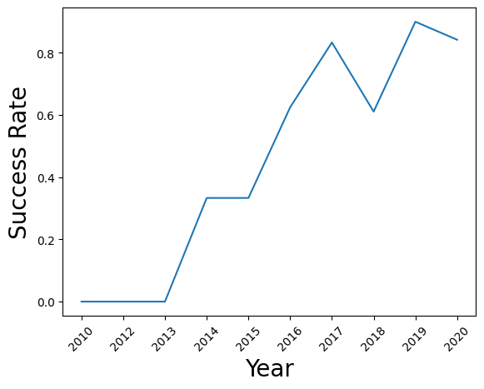
Launch Success Yearly Trend
Show a line chart of yearly average success rate
Show the screenshot of the scatter plot with explanations

Slide 23
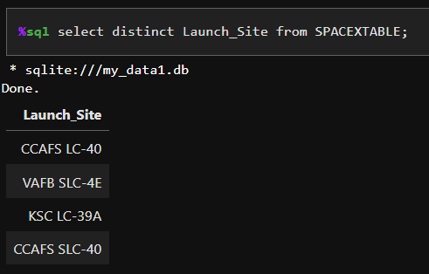
All Launch Site Names
The following quary takes the variable Launch_Site from the table SPACEXTABLE and shows the unique values.

Slide 24
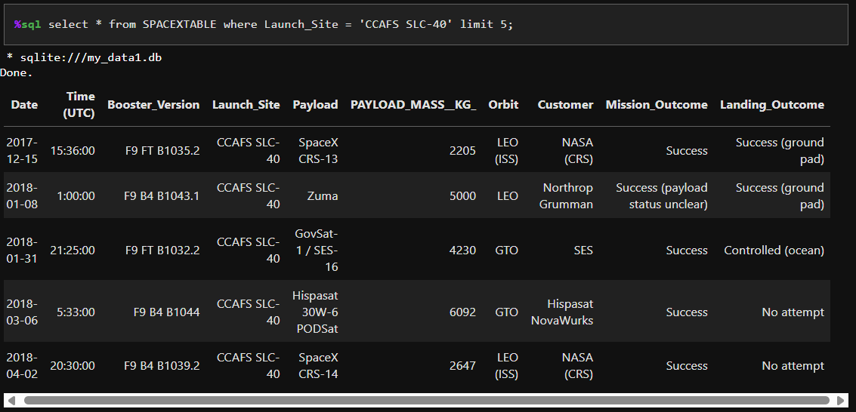
Launch Site Names Begin with 'CCA'
This code takes the variable Launch_Site from the table SPACEXTABLE and extracts 5 rows where Launch_Site is “CCAFS SLC-40”.

Slide 25
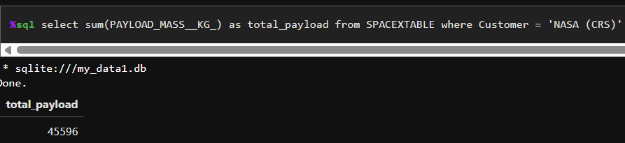
Total Payload Mass
The following query calculates the sum of PAYLOAD_MASS_KG for all rows from SPACEXTABLE table where Customer is “NASA (CRS)”

Slide 26
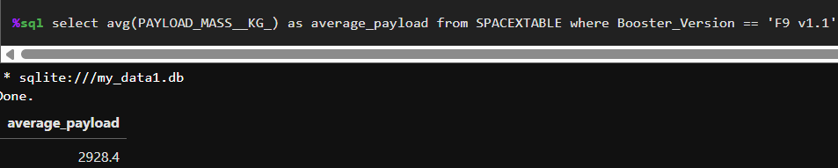
Average Payload Mass by F9 v1.1
The following query calculates the average of PAYLOAD_MASS_KG for all rows from SPACEXTABLE table where Booster_Version is “F9 v1.1”

Slide 27
First Successful Ground Landing Date
The following query finds the date of the first successful landing on the SPACEXTABLE dataframe
%sql select min(Date) as first_successful_landing from SPACEXTABLE where Mission_Outcome = 'Success' and Landing_Outcome = 'Success (ground pad)' and Date is not null;
The first successful landing was on 2015-12-22
Notes:
%sql select min(Date) as first_successful_landing from SPACEXTABLE where Mission_Outcome = 'Success' and Landing_Outcome = 'Success (ground pad)' and Date is not null;

Slide 28
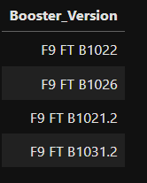
Successful Drone Ship Landing with Payload between 4000 and 6000
%sql select distinct Booster_Version from SPACEXTABLE where Landing_Outcome = 'Success (drone ship)' and PAYLOAD_MASS__KG_ > 4000 and PAYLOAD_MASS__KG_ < 6000;

Slide 29
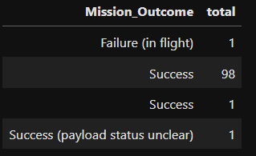
Total Number of Successful and Failure Mission Outcomes
%sql select Mission_Outcome, count(Mission_Outcome) as total from SPACEXTABLE group by Mission_Outcome;

Slide 30
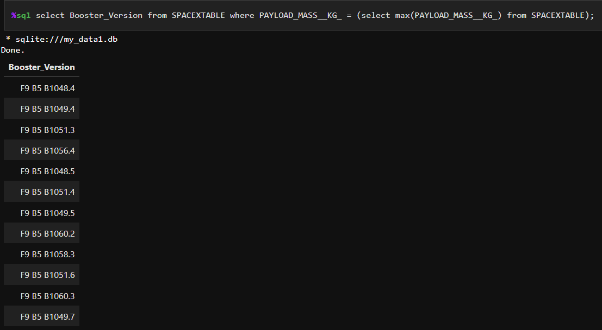
Boosters Carried Maximum Payload

Slide 31
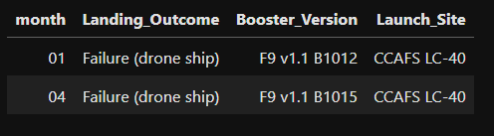
2015 Launch Records
%sql select substr(Date, 6,2) as month, Landing_Outcome, Booster_Version, Launch_Site from SPACEXTABLE where substr(Date,0,5)='2015' and Landing_Outcome = 'Failure (drone ship)' order by month;

Slide 32
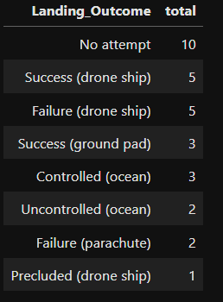
Rank Landing Outcomes Between 2010-06-04 and 2017-03-20
%sql select Landing_Outcome, count(Landing_Outcome) as total from SPACEXTABLE where Date between '2010-06-04' and '2017-03-20' group by Landing_Outcome order by total desc;

Slide 33

Section 3

Slide 34
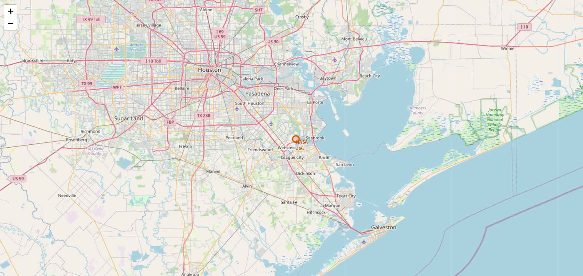
NASA Houston, Texax

Slide 35

Launching sites

Slide 36
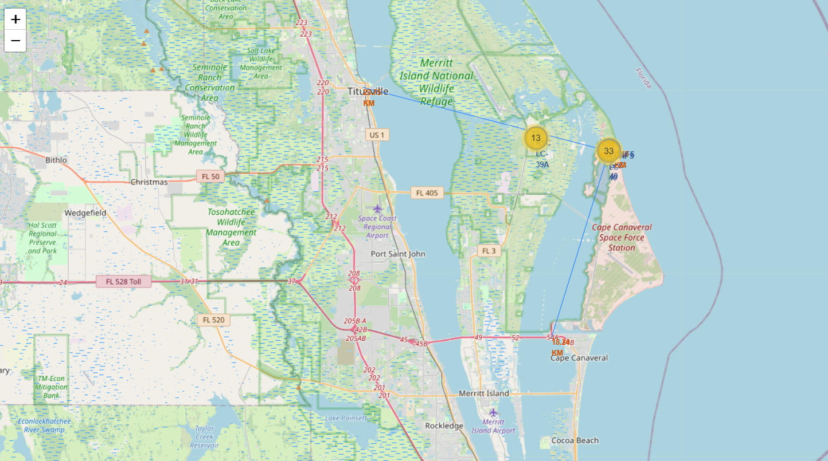
Distance to sites of interest

Slide 37

Section 4

Slide 38
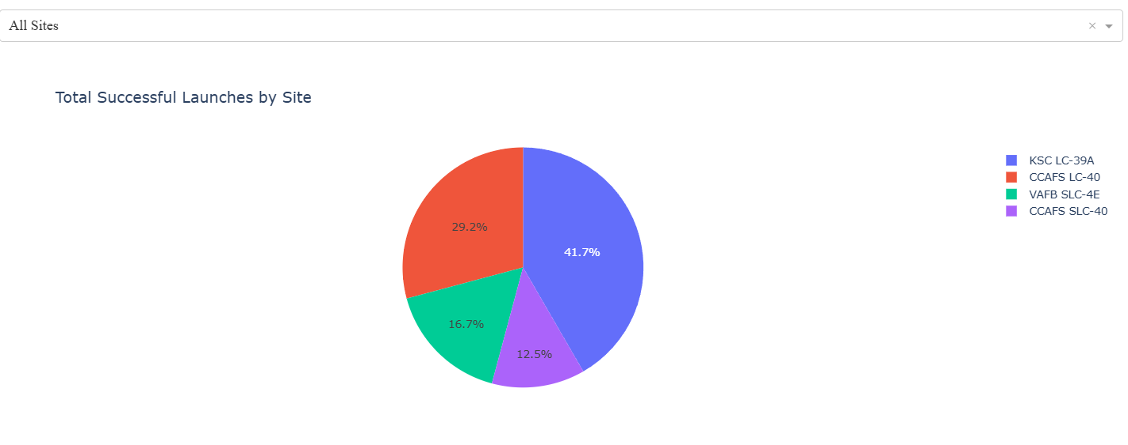
Successful Launches
In the following plot we can observe the percentage of succesfull launches by launching site. The location with the highest success is KSC LC-39A

Slide 39
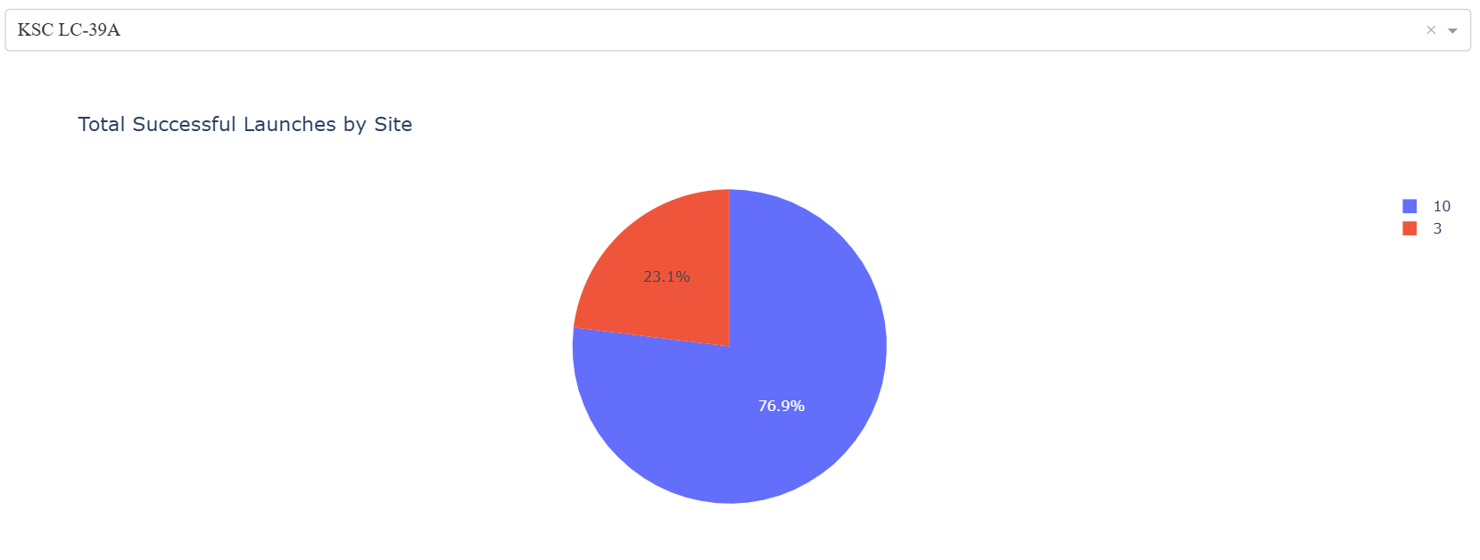
Successful Launches on KSC LC-39A
Following the previous plot, here we observe the proportion of successful launches on KSC LC-39A. 76.9 % of the launches were successful.

Slide 40
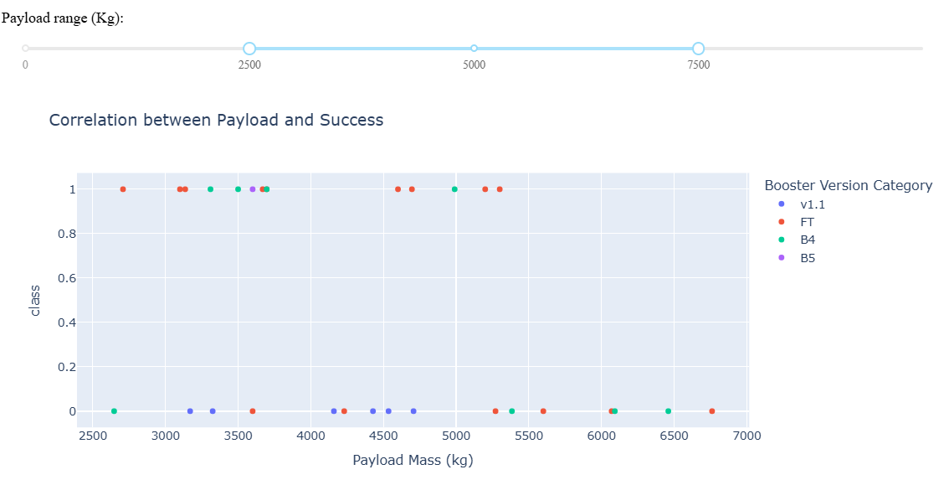
Payload vs Success
Here we observe the correlation between Payload and Success, using the payload range between 2500-7500 (Kg).

Slide 41

Section 5

Slide 42
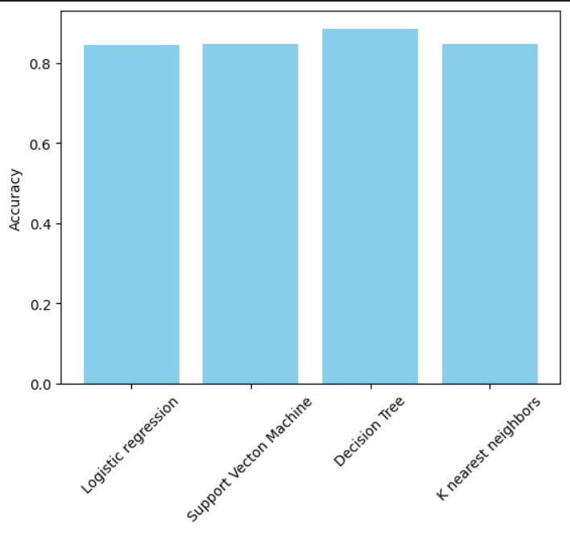
Classification Accuracy
The plot compares the accuracy of all models. For this comparison the model used is the one with the best parameters. Based on this plot, the decision tree model has the higher accuracy.

Slide 43

Confusion Matrix
The confusion matrix shows that the model predicted correctly 15 of the 18 samples in the test data.
Only 3 samples that did not landed were predicted wrongly (as landed)

Slide 44
Conclusions
SPACEX API and Falcon9 Wikipedia were useful for predicting successful landings
Plotly dashboard is appropiate to show data
Decision Tree (with adequate paramenters) proved the best model

Slide 45

Appendix

Slide 46


